Slide 1
Goods & Service Tax (GST)
An Overview
Damania & Varaiya
Chartered Accountants

Slide 2
Goods & Service Tax (GST)
An Overview
Damania & Varaiya
Chartered Accountants

Slide 3
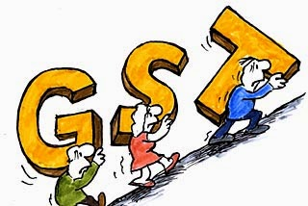
GST – Global Scenario
More than 140 countries have GST (including EU, Australia, New Zealand, Asia Pacific, Canada). Malaysia last to join the wagon w.e.f 01-04-2015.
Most countries have single GST. Brazil and Canada have dual GST.
Standard rate in most countries between 15% to 20%; however, lower in Australia and some other countries.
Damania & Varaiya Chartered Accountants
3

Slide 4
Current Indirect Tax Structure
I. CENTRE
Levy | Taxable event
1) Excise duty | Manufacture
2) Customs duty | Import & Export
3) Countervailing and additional Customs duty, Tax in lieu of Excise Duty | Import of goods
4) Service tax | Provision of Service
5) Central sales tax | Sale of goods in course of Inter-State trade, movement of goods
6) Cess (on various commodities, like, coffee, rubber etc.) | Transactions in commodities
Damania & Varaiya Chartered Accountants
4

Slide 5
Current Indirect Tax Structure (Continued...)
II. STATE
Levy | Taxable Event
1) Additional Excise Duty on certain products like alcohol in lieu of VAT | Manufacture
2) VAT or sales tax | Intra-State Sales
3) Entertainment & Luxury tax | luxuries amusements, betting and gambling
4) Electricity duty and other taxes | Consumption or sale of electricity
5) Purchase tax (in lieu of sales tax) | On purchase of goods
Damania & Varaiya Chartered Accountants
5

Slide 6
Current Indirect Tax Structure (Continued...)
II. STATE(CONTINUED)
Levy | Taxable Event
6) Entry Tax on prescribed goods | Entry into local areas for sale or consumption
7) Stamp duty | Execution of instruments (for commercial /other transactions)
8) Motor vehicle tax | On purchase of vehicles
9) Taxes on Goods and passenger | On passenger and goods being carried by road by any motor vehicle
10) Octroi Duty | On entry of goods in certain municipal jurisdictions
Each Central levy is through a separate enactment
State levies are by separate enactments in each State
Damania & Varaiya Chartered Accountants
6

Slide 7
Obstructions created by Current Indirect tax Structure
Taxable events different
Multiple levies at different rates, in different states and at Central level – many not eligible for set off e.g. CST. Service providers not eligible for vat-set off & vice versa resulting in cascading effect. Even when eligible, reduction therein raises ultimate cost
Double taxation of various transactions e.g. software – works Contract
All-round disputes on valuation, classification, set off eligibility
Compliances with plethora of central & state laws extremely cumbersome & hindrance to business
High cost & lower competitive strength
Low GDP
Damania & Varaiya Chartered Accountants
7

Slide 8
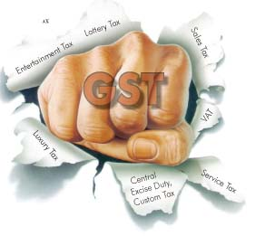
Hence GST – Single levy wherein taxes will be subsumed
GST Meaning – Single Levy
“Any tax on supply of goods or services or both except taxes on supply of the alcoholic liquor for human consumption.”
GST to be a nationwide comprehensive tax levy on manufacturing & supply of goods as well as on service – on every stage, on the principle of value addition
Basis shifted from origin state to destination state
Benefits:
Supposed to be an uninterrupted chain & hence full ITC credit
Ease of compliance
Ease of administration
Eventually reduction in cost
Higher competitive strength
Higher GDP
Damania & Varaiya Chartered Accountants
8

Slide 9
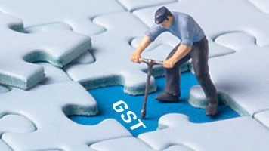
GST
Outside purview (alcohol for human consumption)
Petroleum products (i.e. crude, HSD, petrol, natural gas & ATF) Electricity duty – to be brought within GST purview at later date
Taxes to continue
Basic Custom Duty
Octroi by local authority
Stamp duty
Vehicle Tax
Electricity duty
Damania & Varaiya Chartered Accountants
9

Slide 10
Taxes proposed to be Subsumed
Central Taxes | State Taxes
Central Excise Duty | VAT/ Sales Tax
Additional Excise Duties | Entertainment Tax (unless it is levied by the local bodies)
The Excise Duty levied under the Medicinal and Toiletries Preparation Act | Luxury tax
Service Tax | Taxes on lottery, betting & gambling
Additional Customs Duty, commonly known as Countervailing Duty (CVD) | State cesses and Surcharges in so far as they relate to supply of Goods & Services, and
Special Additional Duty of Customs-4% (SAD) | Entry tax not in lieu of Octroi
Surcharges and Cesses on above Taxes
Damania & Varaiya Chartered Accountants
10

Slide 11
Salient features of GST
Single & Comprehensive levy on supply of goods & services simultaneously by Central & State Government i.e. CGST & SGST
On Supply & not sale - so branch transfer & consignment transfer covered
Composition Scheme provided for
Reverse Charge Mechanism (RCM) by Centre as well as States for services & goods both
Damania & Varaiya Chartered Accountants
11

Slide 12
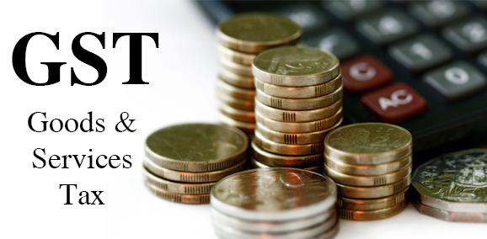
Salient features of GST
Continued…
Barter & Exchange Covered
GST on Exports & Imports of goods & services IGST on Import
Highseas ?
Inter state Supply IGST (Integrated Goods & Service Tax)
1% additional tax on inter state supply of goods but not services - not creditable – for originating state – 2 years.
No declarations required
Damania & Varaiya Chartered Accountants
12

Slide 13
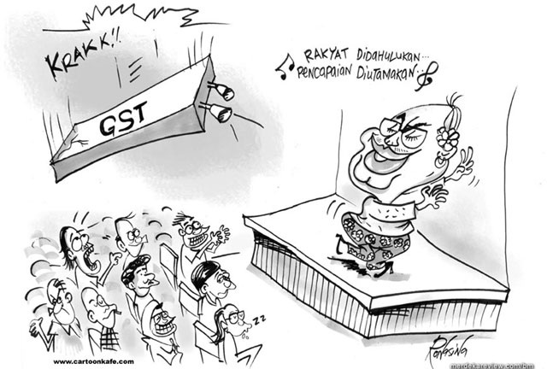
Rate Structure
Rate
Structure
Exempted
Special Rate (Precious Metals)
Lower
Rate
(Essential goods)
Standard
Rate
High
Rate
(Demerit goods)
Damania & Varaiya Chartered Accountants
13

Slide 14
GST Committee on Revenue Neutral Rate (RNR)
Recommendation in brief:
 | RNR | Rate on precious metals | “Low” rate (goods) | “Standard” rate (goods and services) | “High / Demerit” rate
Preferred | 15 | 6 | 12 | 16.9 | 40
 |  | 4 |  | 17.3
 |  | 2 |  | 17.7
Alternative | 15.5 | 6 | 12 | 18.0 | 40
 |  | 4 |  | 18.4
 |  | 2 |  | 18.9
Damania & Varaiya Chartered Accountants
14

Slide 15
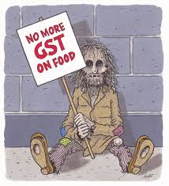
GST Committee on Revenue Neutral Rate (RNR)
Continued…
Exemption list to be restricted to few merit goods e.g. food items
Exemption should be common across States & Centre
Proposed 1% extra tax on inter state supply of goods should be replaced by GST
40% rate to apply to demerit goods like luxury cars, aerated beverages, tobacco/products, paan masala etc.
Damania & Varaiya Chartered Accountants
15

Slide 16
Way forward –
Constitutional Amendment Bill (CAB)
Rajyasabha:
Passage by more than 50% of members and by 2/3 of those present & voting
President to give assent for enactment of CAB
CAB to be ratified by at least 50% states
GST council to be formed to recommend on key aspects
Central & States to draft GST Acts & Rules
Damania & Varaiya Chartered Accountants
16

Slide 17
Way forward - CAB
Continued…
Inviting Public Comment
Central & State administration to be framed
Central & State to enact GST Acts & Rules
Robust GSTN / IT system to be rolled out
Operation of GST Acts & Rules
Damania & Varaiya Chartered Accountants
17

Slide 18
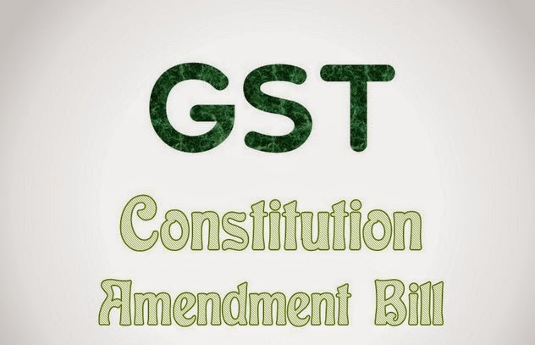
CAB
CAB : Passed by Parliament / Awaiting Rajyasabha approval
Mainly for What:
To authorise states to tax supply of services
To authorise centre to tax supply of goods
To authorise centre to tax inter – state supplies & import
To set up GST council
To decide dispute settlement mechanism
Functions of GST Council – To recommend:
Which taxes to be subsumed in GST
Goods & services to be exempted or subjected
to tax
Model GST Law
Threshold limit
Rates including floor rates with bands of GST
Principles of levy & place of supply
Damania & Varaiya Chartered Accountants
18

Slide 19
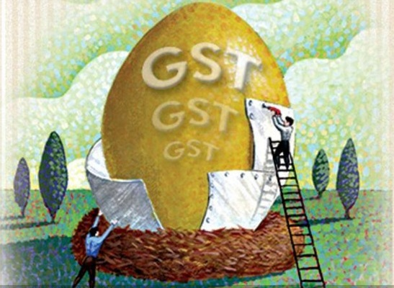
Proposed GST
Intra-State
Central
GST
State
GST
Inter-State
Integrated
GST
GST
The basic features of law, it appears, such as:
- charge,
- taxable event and taxable person,
- measure of levy including valuation provisions,
- basis of classification, etc.
would be uniform across these statutes as far as practicable.
Damania & Varaiya Chartered Accountants
19

Slide 20
Input Tax Credit
Condition:
Tax – invoice
Receipt of goods / services
Tax paid in treasury
Disallowance – main cases:
Car
Immovable property
Goods / services used for private / personal consumption
Damania & Varaiya Chartered Accountants
20

Slide 21
Composition Scheme
Composition Levy (in lieu of tax on supply of goods and/ or services) :
The CG/ SG may permit a registered Taxable person (other than a inter state supplier) :
whose turnover in a financial year < Rs 50 lakh,
to pay an amount calculated at such rate, not less than 1%, of the turnover during the year.
Person opting composition, shall not charge tax on supplies nor shall be eligible for credit.
Damania & Varaiya Chartered Accountants
21

Slide 22
Credit Mechanism
SGST
IGST
SGST
CGST
IGST
CGST
IGST
CGST
IGST
SGST
Damania & Varaiya Chartered Accountants
22

Slide 23
Goods
- Defined as per Constitution :
“goods” includes all materials, commodities and articles
Defined as per Model Law :
“goods” means every kind of movable property other than actionable claim and money but includes ” securities, growing crops, grass and things attached to or forming part of the land which are agreed to be severed before supply or under the contract of supply”
Defined as per MVAT Law :
“goods” means every kind of movable property not being newspapers, actionable claims, money, stocks, shares, securities or lottery tickets and includes live stocks, growing crop, grass and trees and plants including the produce thereof including property in such goods attached to or forming part of the land which are agreed to be severed before sale or under the contract of sale:
Damania & Varaiya Chartered Accountants
23

Slide 24
Goods
Differences in Model Law & MVAT :
MVAT law excludes newspapers, stocks, shares, securities or lottery tickets
Model law includes securities, newspapers and lottery tickets
Damania & Varaiya Chartered Accountants
24

Slide 25
Service
- Defined as per CAB :
“Services means anything other than goods”
- Defined as per Model Law :
“Services means anything other than goods”
Anything and everything under the sun ?!?
Effects ?!?
-Would it cover ?
Works Contract - Actionable Claims
Liquidated damages
Software
Immovable property
Intangibles
Damania & Varaiya Chartered Accountants
25

Slide 26
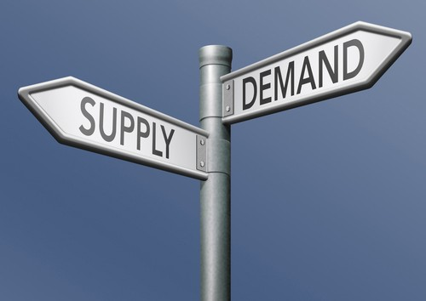
Supply
(as proposed to be defined as per model law)
Inclusive definition
Normal/Natural meaning of supply
The term “supply” as per T.P Mukherjee’s Law Lexicon is merely a form of sale and dispatch, and unless there was sale there was no supply of goods. The words sale and supply go together.
The term “supply” as per Black’s Law Dictionary is the amount of goods Produced or available at a given price.
Includes all forms of supply such as:-
- Sale - Exchange
- Transfer - License
- Barter - Rental
Lease or disposal and importation of services
For a consideration
By a person
In the course or for furtherance of business
Damania & Varaiya Chartered Accountants
26

Slide 27
Supply
(as proposed to be defined as per model law) (Contd…)
Made/agreed to be made includes deemed Supply (Schedule I without consideration)
Permanent transfer/ disposal of business assets (Nature covered?) (To Discuss)
Temporary application of business assets to a private or non-business use
Services put to a private or non-business use
Self supply of goods and/or services (Nature and extent?) (To discuss)
Assets retained after deregistration
Damania & Varaiya Chartered Accountants
27

Slide 28
Supply
(as proposed to be defined as per model law) (Contd…)
Schedule II
Nature of Supply (With consideration) | Includes | Treated as Supply of
Transfer | of title in goods | Goods
 | of goods or of right in goods or of undivided share in goods without transfer of title | Service
 | of title in goods with a condition that property in goods will pass at a future date upon payment of full consideration | Goods
Damania & Varaiya Chartered Accountants
28

Slide 29
Supply
(as proposed to be defined as per model law) (Contd…)
Schedule II
Nature of Supply (With consideration) | Includes | Treated as Supply of
Land & building | Any lease, tenancy, easement, license to occupy land | Service
 | Any lease or letting out of building including commercial, industrial or residential complex for business or commerce, either wholly or partly | Service
Treatment & process | Any treatment or process applied to another person’s goods | Service
Damania & Varaiya Chartered Accountants
29

Slide 30
Supply
(as proposed to be defined as per model law) (Contd…)
Schedule II
Nature of Supply (With consideration) | Includes | Treated as Supply of
Transfer of business assets | Where goods forming part of assets of a business are transferred or disposed of whether or not for a consideration, such transfer or disposal | Goods
 | Goods held or used for business are put to any private use or are used, or made available to any person for use, for non-business purpose whether or not for a consideration, the usage or making available of such goods | Service
Damania & Varaiya Chartered Accountants
30

Slide 31
Time of supply of goods, generally
Dependant on “ destination” based principle
Dependant on terms of supply
Earliest of:
- Removal / making available
- Invoicing
- Payment
- Reflection of receipt in buyer’s books
If none of above:
- Due date of return; or
- GST payment
Damania & Varaiya Chartered Accountants
31

Slide 32
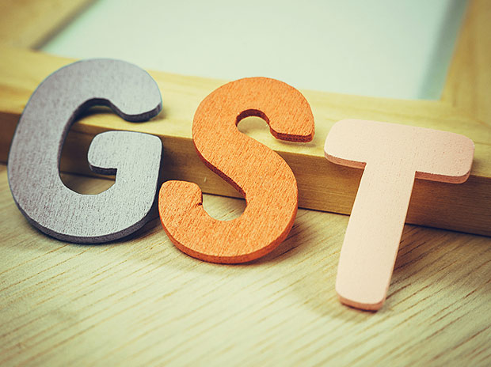
Place of supply of goods, generally
Based on principle of ‘Destination’
Generally, location of delivery
Specific cases also, generally, location of delivery (like, installation site; location of placing goods on board- in case of vessel, train, etc.)
Location of consumption, in case of gas
Damania & Varaiya Chartered Accountants
32

Slide 33
Time of supply of services, generally
Dependent on “destination” based principle
Dependant on terms of contract
Governed by: timely invoice
Generally, earliest of the following :
- Date of invoice
- Date of completion
- Date of Payment
If none of above:
- Due date of return; or
- GST payment
Damania & Varaiya Chartered Accountants
33

Slide 34
Place of supply of services, generally
Destination principle followed
Terms of contract, where different states involved an apportionment
Certain services, place of performance (like, location of movables)
Certain services relating to immovable, location of immovable
Existing Rules may be followed
Where service to Registered person, location of recipient (as defined)
Where service to unregistered person, location of recipient as per records of provider.
Damania & Varaiya Chartered Accountants
34

Slide 35
Location of Service Provider/ Recipient
Provider
Supply from Location
Registered Business establishment Registered Place
Fixed Establishment (other than Registered place) Fixed Place
From more than one establishment Place most directly connected
None of the above Usual place of residence
Received at Location
Registered Business establishment Registered Place
Fixed Establishment (other than Registered place) Fixed Place
From more than one establishment Place most directly connected
None of the above Usual place of residence
Damania & Varaiya Chartered Accountants
35

Slide 36
Nature of Supply- Inter-State/ Intra-State (Contd…)
Relevant Factors :
Destination principle
Different criteria
Different situations in location of supplier/ recipient and/ or place of supply
Accordingly, determination of inter-state or intra-state supply
If inter-state, effect of casual trading incase of service supply
Damania & Varaiya Chartered Accountants
36

Slide 37
Taxable Persons/ Entities under GST
Defined as per Model Law :
“Taxable Person means a person who carries on any business at any place in India /State of ____ and who is registered or required to be registered under Schedule III of this Act for payment of tax”
Taxable person shall include the following :
all types of persons carrying on business activities, i.e. manufacturers, job- workers, traders, importers, exporters, all types of service providers, etc.
The Central Government, a State Government or any local authority
All branches of a company situated in different states will be considered as taxable entities under each of the jurisdictions of State Governments concerned.
Damania & Varaiya Chartered Accountants
37

Slide 38
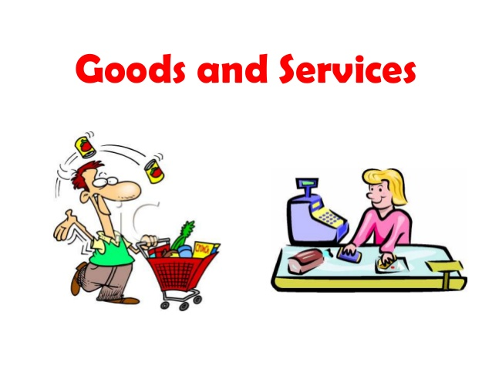
Value of Taxable goods/ and or services
Methods of determination of value :
Value shall be the transaction value.
Transaction value is the price actually paid or payable for the said supply where the supplier and recipient are not related & price is the sole consideration
Transaction value shall be the value determined in monetary terms
b) Where goods are transferred from –
- one place of business to another place of the same business
- principal to agent or vice versa
the value of such supply shall be transaction value.
Damania & Varaiya Chartered Accountants
38

Slide 39
Value of Taxable goods/ and or services
c) Where value of a supply cannot be determined under the above rule, value shall be determined on the basis of –
- Value of supply by comparison (Comparable Uncontrolled Price method)
- Computed value method (Cost plus method)
- Residual method (Reasonable means having regard to Rules)
d) Valuation in certain cases :
Pure agent : exclusion of certain expenses
Money Exchanger : Difference in sale/ Purchase rate and RBI Reference rate
or
1% based on value as per RBI Reference rate
Damania & Varaiya Chartered Accountants
39

Slide 40
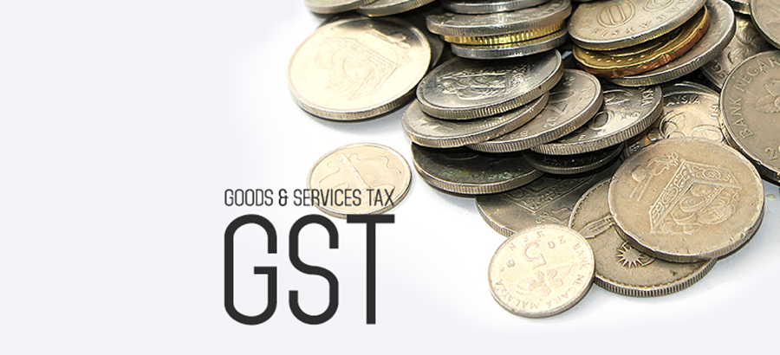
Concept of MRP
Legal Metrology Act 2009 – Tax on price required to be declared on package – sale by taxable person to non taxable person
Damania & Varaiya Chartered Accountants
40

Slide 41
Registration (Contd…)
Salient Features of Registration :
PAN based Registration: PAN will be mandatory
Unified application to both tax authorities
To be filed within 30 days
State-wise registration for entities having presence in more than one State
Need not apply separately for each State
Deemed approval within three days
Within a PAN, separate registration for separate business verticals within a State possible
15 digit alpha-numeric structure based on PAN
Damania & Varaiya Chartered Accountants
41

Slide 42
Registration
Who may Register?
I. Persons liable to be registered that is ;
(i) Persons registered to pay existing taxes that will be subsumed under GST (auto migration)
(ii) Persons with All-India Gross Turnover (including export and tax free goods) more than a threshold
(iii) Persons making interstate supplies
(iv) Casual and non-resident suppliers
(vi) Unique-ID for specific class of persons
(vii) Transferee of a business
(viii) Persons liable to pay Tax under RCM
II. Voluntary Registration below threshold
Damania & Varaiya Chartered Accountants
42

Slide 43
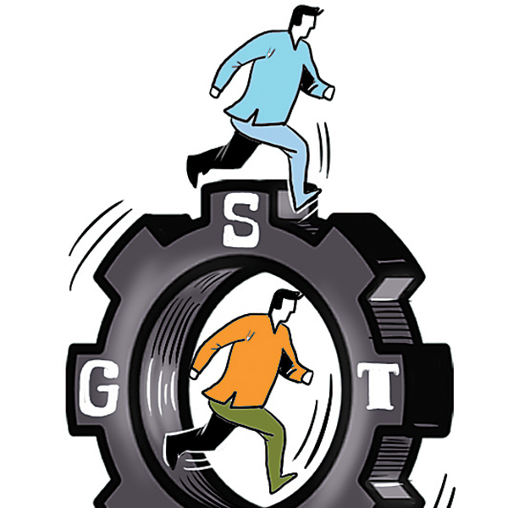
Registration Returns - Payment
Registration:
Existing registration under any revenue law of centre or state
Registration in each state
More than one registration for separate verticals
Returns:
Combined for SGST + CGST + IGST + Additional Tax
Ten days – outward supply
Fifteen days – inward supply
Twenty days – monthly return
Concept of “Compliance Rating”
Damania & Varaiya Chartered Accountants
43

Slide 44
Questions
Damania & Varaiya Chartered Accountants

Slide 45
Thank You
Damania & Varaiya
Chartered Accountants

