Slide 1
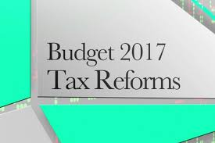
Budget 2017 - Highlights

Slide 2
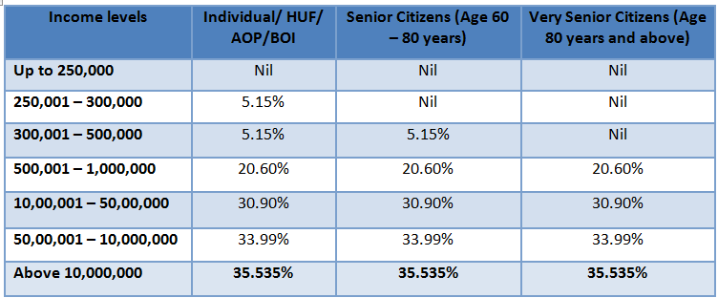
TAX RATES
Personal Income Tax

Slide 3
Surcharge of 10% of tax payable on categories of individuals whose annual taxable income is between Rs 50 lakhs and Rs 1 crore. Above 1 crore the same surcharge of 15% shall continue.
Rebate u/s. 87A is reduced to maximum of INR 2,500 from the present limit of INR 5,000 and will be available only in case of income up to INR 3.5 lakhs instead of INR 5 lakhs.
Simple one-page form to be filed as Income Tax Return for the category of individuals having taxable income upto Rs 5 lakhs other than business income.
Deduction for NPS contribution (Sec 80CCD) increase the ceiling of deduction from 10% to 20% of the gross total income for a non-employee contributing to NPS.

Slide 4
Deduction under section 80G – Donation:
Deduction u/s. 80G is not allowed if donation in excess of INR 10,000 is made in cash.
It is now proposed to reduce this limit to INR 2,000.

Slide 5
CORPORATE TAX:
The rate of income tax for Companies with annual Turnover or Gross receipts up to INR 50 crores in the financial year 2015 – 16 is reduced from 30% to 25%.
Minimum Alternative Tax (MAT):
Tax credit under MAT was allowed to be carried forward up to 10th year.
It is now proposed that such tax credit can now be carried forward up to 15th year
Section 115BBDA
Income by way of dividend in excess of INR 10 Lakhs is chargeable to tax at the rate of 10% on gross basis in case of a resident individual, HUF or firm.
It is proposed to extend the scope of this provision to all resident assesses, except domestic companies and specified funds, trusts, institutions.

Slide 6
Other Taxations
Foreign Portfolio Investor(FPI) Category I & II exempted from indirect transfer provision.
CHARITABLE TRUST
Any corpus donation made by one trust to other trust or institution
Was treated as application of Income.
But with the proposed amendment its shall not be treated as application of income for charitable or religious purposes.
Clarification to obtain Fresh Registration.

Slide 7
Electoral Funding
Political parties registered with the Election Commission of India are exempt from paying Income Tax.
There is no restriction on receipt of any amount of donation in cash by a political party.
It is now proposed to provide that:
No donation of INR 2,000 or more can be accepted in cash;
Political party must furnish Return of Income before the prescribed time limit.
Voluntary contribution other than by way of electoral bonds in excess of 20,000/- then Political parties are required to maintain the requisite records.

Slide 8
House Property & Capital Gains
Holding period for Long-term capital gains tax on immovable property from three years to two years.
For Joint Development Agreement signed for development of property, the liability to pay capital gain tax will arise in the year the project is completed.
Tax on notional rental income will only apply after one year of the end of the year in which completion certificate is received.
Change in the base year of Indexation : to 1- Apr-2001 from 1-Apr-1981 for all classes of assets including immovable property.

Slide 9
The conversion of preference share into equity share will NOT be regarded as a taxable transfer.
Exemption of Long Term Capital Gains:
Long Term capital gain on sale of equity share of unit of an equity oriented fund is exempt from tax if Security Transaction Tax (STT) is paid on the transaction of sale
It is proposed not to allow the exemption to the shares that are acquired after 1st October 2004 on which the STT is not paid.

Slide 10
Capital Gain on Rupee denominated bonds issued outside India by Indian Company:
Gain arising out of appreciation of rupee against a foreign currency at the time of redemption by the subscriber was not taxable
It is proposed to extend benefit even to secondary holders as well.
It is also proposed to exempt transfer of such bonds from non-resident to non-resident.

Slide 11
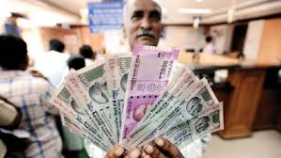
Profits & Gains From Business & Profession
Promoting Digital Economy
Under section 40A(3), payment made to a person in a day in respect of any expenditure incurred in cash in excess of INR 20,000 is not allowed as deduction from income.
It is proposed to reduce this cash payment limit to INR 10,000.
It is further proposed that depreciation shall not be allowed in respect of Capital asset over INR 10,000, if the payment is made in cash.

Slide 12
Tax on Presumptive Income 44AD:
Currently, eligible assessee engaged in eligible business whose total turnover is less than INR 2 crores, 8% of the turnover may be presumed to be his Net Income.
It is proposed that in respect of such amount of turnover that is transacted by any digital mode, only 6% may be presumed to be his Net Income.
S.44AA : Monetary Limit increased from 1.20 lakhs to 2.50 lakhs & from 10 lakhs to 25 lakhs.

Slide 13
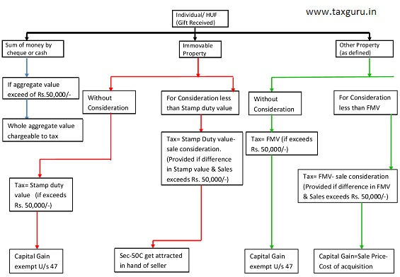
Income From Other Sources & SET OFF CARRY FORWARD

Slide 14
Section 56(2)(Viia) :- Gift received by firm or closely held company:-
Where a firm or closely held company received from any person or persons shares of a closely held company .
a) Without consideration, the aggregate fair market value of which exceeds Rs. 50,000/-, the whole of the FMV of such shares.
b) For a consideration which is less than FMV of shares and difference between consideration or FMV exceeds Rs. 50,000/- , then such excess shall be taxable.

Slide 15
The Proposed Amendment is as under:-
S.56(2) (x):- The provisions of S.56(2)(vii) & (viia) shall stand abated & thus the said new section be applicable to all assesses subjected to certain exceptions.
Further, the recipient is liable to tax in the aforesaid manner, the value which has been subjected to tax will be available as cost in the hands of such recipient.
Losses from house property against any other income shall be restricted upto Rs.2 Lakhs only for any assessment year.

Slide 16
Eligible Start-ups: Section 80-IAC
An eligible start up is allowed a tax deduction of 100% of its profit from eligible business for 3 consecutive years out of 5 years beginning from the year in which the eligible start-up is incorporated
The condition is relaxed for 3 consecutive years out of 7 years
Any loss incurred by a Company was allowed to be carried forward and set-off against income of the subsequent years only if at least 51% of the equity with voting power were same.
For eligible start-ups, the condition of 51% of voting power is relaxed subject to condition that holding of original promoters continue.

Slide 17
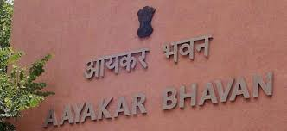
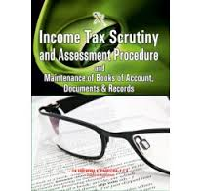

Slide 18
Assessment Procedure
S. 139(1) : In order to claim exemption u/s 11 & 12, one additional condition is added i.e to file Return of income within the due date of furnishing return of income specified u/s 139 (1) of the IT Act.
S.139(5) : The time for furnishing of revised return shall be available upto the end of the relevant assessment year or before the completion of assessment, whichever is earlier.
S. 234F r.w. S.139(1):-
Situations | Late filing Fees
If ITR is filed after due date but before 31st December | 5,000/-
After 31st December | 10,000/-
Where total income in ITR does not exceed INR 5 Lakhs | 1,000/-

Slide 19
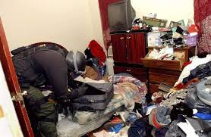

Slide 20
There was requirement to disclose the reason of Search/ Provisional Attachment of Property.
Now with the Proposed Amendment the reasons behind undertaking search is not required to be disclosed.
The maximum period for the provisional attachment is proposed to be 6 months.
Within 60 days from the date on which the last of the authorizations for search was executed, a reference to Valuation Officer may be made who shall estimate fair market value of property.
Now the time limit for making assessment order is as follows:-
Section | Asst. Year | Time Limit for making order
143 & 144 | 2018-19 | Within 18 month from the end of assessment year
143 & 144 | 2019-20 | Within 12 month from the end of assessment year

Slide 21
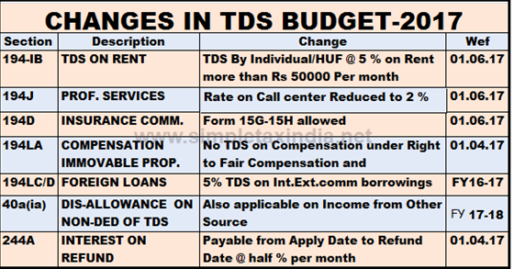
TDS

Slide 22
TCS

Slide 23
Promoting Digital Economy
It is proposed to insert a new Section 269ST to provide that no person shall receive an amount of INR 3 Lakhs or more –
in aggregate from a person in a day;
in respect of a single transaction; or
in respect of transactions relating to one event or occasion from a person.
Otherwise than by any digital mode.
Penalty is proposed to be a sum equal to the amount of such receipt.

Slide 24
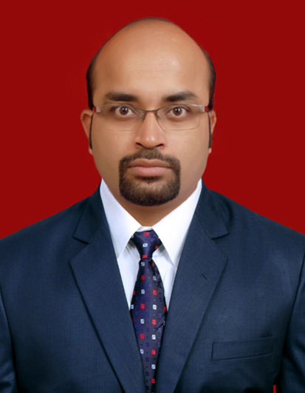

Slide 25
Section 92BA:-
Expenditure in respect of which payment has been made by the assessee to a person referred to in under section 40A(2)(b) where within the ambit of SDT.
With proposed amendment 40A(2)(b) is excluded from the scope of section 92BA of the Act.
The scope of domestic transfer pricing to be restricted to cases where at least one of the entities involved in related party transaction enjoys specified profit-linked deduction.

Slide 26
Anti-Abuse measures
Secondary adjustments Section 92CE:
Where as a result of primary adjustment in the Transfer Pricing assessment, there is increase in total income or reduction in loss.
It is proposed that the excess money, if not repatriated to India, shall be deemed to be an advance made to AE. Interest on such advance shall be computed as income of the assessee.
This provision shall not apply if the primary adjustment does not exceed INR 1 crore.

Slide 27
Example for Section 92CE
Indian Company Sales to it’s AE @ 120/- (Assume the Transaction took place after 01/04/2017)
ALP = 140/-

Slide 28
Anti-Abuse measures
Thin Capitalization – Limitation on interest claim:
It is proposed to insert a new section 94B to provide that interest expense claimed by an entity to its Associated Enterprise (AE) shall be restricted to 30% of its earnings before interest, taxes, depreciation and amortization (EBITDA).
Further, a debt shall be deemed to be treated as issued by an AE where it provides guarantee to the lender.
Such excess interest shall be allowed to be carried forward up to 8 assessment years and can be reduced from the income to the extent of maximum allowable interest.
The provision shall not be applicable in case the interest expense does not exceed INR 1 crore.

Slide 29
Example for 94B

Slide 31
PRESENTED & PREPARED BY:-
AMI D .SHAH
SAVITA S .POTE

