Slide 1
Companies Act, 2013 Related Party Transactions
Nilay Shah || Arpita Gadodia
M.V. Damania & Co.
Chartered Accountants

Slide 2
1.Director or its Relative
Relative u/s 2(77)
Members of
HUF
Husband & Wife
Father & Mother
Son & Daughter
Daughter’s Husband
Son’s Wife
Brother & Sister
Director u/s 2(34) means a director appointed to the Board of a Company.

Slide 3
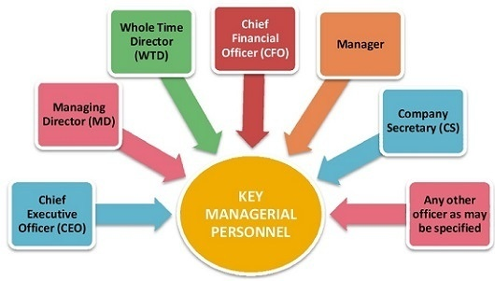
2. KMP or his relative

Slide 4
3. A firm, in which a director, manager or his relative is a partner;
Mr. A
Partner
Director/Relative
ABC & Co.
(Firm)
XYZ Ltd.
Related
Party

Slide 5
4. A private company in which a director or manager is a member or director;
Mr. A
Member/ Director
Director/Manager
ABC Pvt. Ltd.
XYZ Ltd.
Related
Party

Slide 6
5. A public company in which a director or manager is a director and holds along with his relatives, more than two per cent. of its paid-up share capital;
Mr. A
Director and Shareholder holding more than 2% of PSC along with his relatives
Manager/ Director
ABC Pvt. Ltd.
XYZ Ltd.
Related
Party

Slide 7
6. Any body corporate whose Board of Directors, managing director or manager is accustomed to act in accordance with the advice, directions or instructions of a director or manager;
Mr. A
Mr. B
Mr. B is accustomed to act on instructions of Mr. A
Body Corporate u/s 2(11) also includes a company incorporated outside India.
Provided that nothing in this clause shall apply to the advice directions or instructions given in a professional capacity;
Manager/ Director
Board of Director, MD or Manager.
XYZ Ltd.
Body Corporate
Related
Party

Slide 8
7. Any person on whose advice, directions or instructions a director or manager is accustomed to act;
Mr. A
Provided that nothing in this clause shall apply to the advice directions or instructions given in a professional capacity;
Mr. A is accustomed to act on instructions of Mr. B
Manager/ Director
Mr. B
Related
Party
XYZ Ltd.

Slide 9
8.Any company which is— a holding, subsidiary or an associate company of such company; or a subsidiary of a holding company to which it is also a subsidiary;
A Ltd (Holding Company)
Associate Company u/s 2(6)
[Sister Concerns]
Subsidiary Company u/s 2(87)
Holding Company u/s 2(46).
Related Party
B Ltd (Subsidiary )
C Ltd
(Subsidiary)
Related
Party

Slide 10
9.A director or KMP or their relatives of the holding company in reference of a company
C Ltd
(Holding Company)
Director
KMP
Subsidiary
Mr. X& Relatives
KMP of C Ltd & Relatives
D Ltd
(Subsidiary Company)
Related Party
Related Party

Slide 11
CASE STUDY
Q. If A is related to B, does it mean that B is
related to A?
Ans. No. If a is related to B, this does not essentially mean that B is also related to A.
For instance, Co. A is accustomed to act according to the directions of the Director of Co. B, however, Co. B is not accustomed to act according to the directions of the Director of Co. A. In this case, though Co. B is a related party to Co. A, Co. A is not a related party to Co. B.

Slide 12
CASE STUDY
Q. Whether a common director of two private companies are related parties?
Ans. Yes. Section 2 (76) (iv) of the Act, 2013 provides that if a director or manager of any company (private or public) is a director or member in private company, then the private company would be a related party to the other company.
Q. Whether a common director of two Public Companies are related parties?
Ans. Essentially, No. Section 2(76)(v) presently requires if the director of any company (private or public) is also a director of a public company and holds, along with his relatives, more than 2% of its paid-up share capital, then the public company would be a related party.

Slide 13
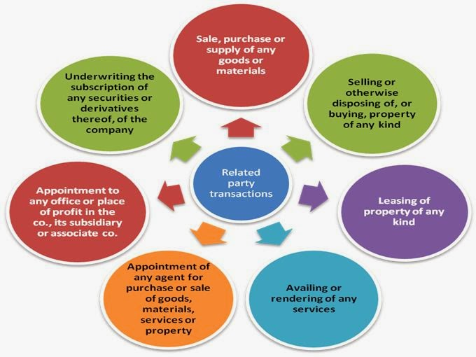
RELATED PARTY TRANSACTIONS

Slide 14
Q. Does lending/guarantee to/for subsidiary come under related party contract?
Ans. Subsidiary is certainly a related party as per section 2(76). However, lending/guarantee to/for subsidiary is not a Related Party Transaction covered under section 188. Loans and guarantees are covered under Sections 186 & 187 respectively.

Slide 15
Q. Mr. A is a CEO in X Ltd. He is paid remuneration of Rs. 12 lakhs p.a. Is this a related party transaction?
Ans. No, this is not a related party transaction. Though, Mr. A, CEO of the Company is a related party to the company, remuneration paid to Mr. A is not covered under Related Party Transaction. Managerial Remuneration is covered under Section 195 of the Companies Act, 2013.

Slide 16
Related Party Transactions | Limits
sale, purchase or supply of any goods or materials directly or through appointment of agents; | 10% of Turnover OR Rs. 100 Crores
selling or otherwise disposing of, or buying, property of any kind directly or through appointment of agents | 10% of Net Worth OR 100 Crores
leasing of property of any kind; | 10 % Net Worth OR 10% Turnover OR 100 crores
availing or rendering of any services directly or through appointment of agents | 10 % of the Turnover OR 50 Crores
appointment to any office or place of profit in the company, its subsidiary company or associate company | Monthly Remuneration 2,50,000/- per month
underwriting the subscription of any securities or derivatives thereof, of the company: | 1% of Net Worth
In case of companies with paid up capital Rs 10 crores or more, Related party transactions should be entered after the shareholders approval by special resolution.

Slide 17
Notes
1. In case of Wholly Owned Subsidiary, the special resolution passed by the holding company is sufficient for entering into the transactions between wholly owned subsidiary and holding company.
2.Interested director/members should not be present/ vote in the meeting for the special resolution approving contract or arrangement with related party.
3.Ratification can be done by Members or Directors within 3 months from date of commencement of Contracts and arrangements.
4.This section shall not apply to transactions in the ordinary course of business provided it is at arm’s length are excluded from Related Party Transactions.
5.Audit Committee Approval under Section 177.

Slide 18
CASE STUDY
Q. Mr. X is a shareholder in Y Ltd. Mrs. X, wife of Mr. X enters into a contract with Y Ltd subject to prior approval of Shareholders via SR. Mr. X is not interested in the special resolution for RPT. Can Mr. X vote on the special resolution to be passed for entering in a RPT?
A. No. The section clearly implies that even if Mr. X is not interested in the related party contract or arrangement, merely by virtue of his being a ‘related party’ to Y Ltd, he is prohibited from voting on such resolution.

Slide 19
(Sec 188)
Contract with RPT
In ordinary course of business/ arm’s length transaction?
Provisions of Sec 188 NA
YES
Audit Committee Approval
NO
Does RPT fall u/s 188 (1) (a) to (g)?
NO
YES
Does it exceed the limits specified in Rule 15?
PUC >10 Crores?
Board Resolution
NO
NO
YES
YES
YES
Special Resolution
MGT-14
File

Slide 20
Disclosures
Agenda of the Board meeting to be convened to discuss the transaction with Related Party to include the detailing of the proposed transaction with respect to its nature, terms of understanding, pricing and other relevant factors, if any.
Every Company has to disclose its Related Party Transactions in its Financial Statements.
Board Report to the shareholder shall include every contract or arrangement as referred above along with its justification.

Slide 21
Register of Contracts
Every Company has to maintain a Register of Contracts for Related Party Transactions and such register has to be produced in the Annual General Meeting of the Company.
Form MBP-1 : Disclosure of Boards Interest
Form MBP-4: Register of Contracts
Exceptions:
1. For the sale, purchase or supply of any goods, materials or services if the value of such goods and materials or the cost of such services does not exceed five lakh rupees in the aggregate in any year; or
2. by a banking company for the collection of bills in the ordinary course of its business.

Slide 22
Penalty
Any director or any other employee of a Company, who had entered into or authorized the contract or arrangement in violation of the provisions of RPT shall be punishable with fine which shall not be less than Rs. 25,000. But which may extend to Rs. 5,00,000.
Every Director who fails to comply with provisions of Register of Contracts shall be liable to a penalty of Rs. 25,000.

Slide 23
ISSUE
For a Related Party Transaction in A Ltd. –
Members holding 60% of shares in A Ltd. are prohibited to vote (because they are interested parties in the transaction)
Remaining 40% members are allowed to vote, being disinterested
Out of 40, 30% approval is required as the transaction requires a special resolution to be passed.
Hence, any disinterested member holding 10% or more shares in A Ltd. can act as a barrier for passing the special resolution causing the functioning of companies difficult i.e ‘Hung Companies’.

