Slide 1
Wealth Management
By Rajesh Shah

Slide 2
Classes of assets
Real estate
Commodities (like gold silver bullion etc.)
Debt
Equity
Liquid
Other Assets

Slide 3
Sources of Income/ Types of Expenditure
Sources of Income
Salary
Business & Professional income
Rental income
Investment income
Type of expenditure
House hold expenses
Life style expenses
Insurance premiums
Loan EMIs
Others

Slide 4
Why People Invest
Interest
Dividend
Capital Appreciation
Satisfy the long term & short term goals
Mitigate Risk

Slide 5
Goals
Major Goals
Own Marriage
Buying A house
Children education
Children marriage
Independent retirement
Minor Goals
Car Purchase
International Vacation
Holiday Home
Home Renovation
Family Gifting
Other Financial goals
Reducing Tax outgo and Tax planning
Protection of Asset & Life
Debt Free
Charity

Slide 6
Investments Strategies
Analyzing the risk
Cash flow
Asset allocation
Monitoring
Review

Slide 7
Risk
Sources & Type of Risk
Interest Rate Risk
Reinvestment Risk
Default Risk
Liquidity risk
Exchange rate risk
Regulatory risk
Investment manager risk
Business risk
Event risk

Slide 8
How to manage the Risk
Insurance
Diversification
Hedging

Slide 9
Cash flow
Daily/Weekly/monthly & yearly budget
Present value & Future value of money
Annuities
Net present value

Slide 10
Asset allocation
Returns
Capital protection
Inflation
Taxation
Liquidity
Divisibility

Slide 11
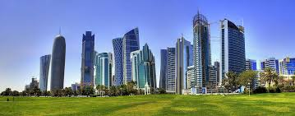
Real Estate
Residential property
Commercial property
Industrial property
Agricultural/urban land
Holiday resort
New instrument
REIT

Slide 12
Gold & Bullion
Coins/Bars/Raw Gold/Silver
Jewellery
Gold & Gold ETF
Gold Bonds

Slide 13
Financial Assets
Small Saving Instruments
Public provident fund
National saving certificates
Post office monthly income scheme
Senior citizen saving scheme
Post service saving scheme
Post office recurring deposit
Kishan Vikas Patra
Marketable & fixed saving instruments
Corporate bonds
Fixed deposits
Central & State Govt. treasury bills
Debt mutual funds
Money market/Liquid funds
Debt / Income fund
Diversified debt fund
Gilt fund
Short term debt fund
High yield debt fund
Fixed term plans

Slide 14
Financial Assets
Equities
Direct Equity
Primary & Secondary market
Private equity
Venture/Seed & Angel capital
Equity mutual funds
Growth Fund
Value Funds
Dividend Yield Funds
Large Cap/Mid Cap/Small Cap Funds
Specialty/Sector Funds
Diversified Funds
Index Funds
Balance/Hybrid Funds

Slide 15
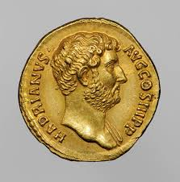
Other Asset
Arts
Coins
Antiques
Stamps
Reverse Mortgage

Slide 16
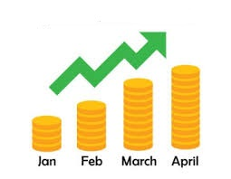
Wealth management by mutual fund
Lump sum
Systematic investment plan (SIP)
Advantage of SIP
Small ticket size
Rupee Averaging
Cover inflation & Interest
Compounding Effect
Tax Free/Efficient

Slide 17
Review & Monitoring
Quarterly analysis
Ratio analysis
Goal linked asset allocation
Shift of investments
Expert Advise

Slide 18
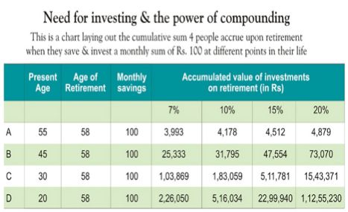
Power of Compounding

Slide 19
Golden Hen
Once, a farmer lived in a village. He was very poor. His income was very small. He passed his days with difficulty. One day, someone gave him a hen. It gave a golden egg every day.
He sold the egg every day. Soon he became a rich man. All began to respect him in the village. He became greedy. He thought that inside the hen there must be a storehouse of golden eggs. He should get them in a day.
Then he would be the richest man in the village. He took a knife and cut the stomach of the hen. He did not get even a single egg. He lost not only the golden eggs but the hen also.
Moral: Greed is a curse.

