Slide 1
INDIAN ACCOUNTING STANDARDS (IND AS)

Slide 2
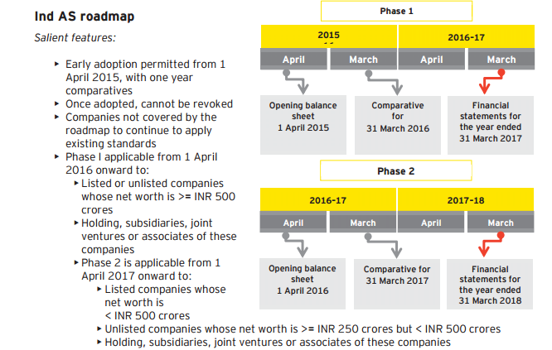
Roadmap to IND AS

Slide 3
INDIAN ACCOUNTING STANDARD 16
PROPERTY, PLANT & EQUIPMENT

Slide 4
Applicability
Inclusions
Exclusions
Tangible items that are held for use in production or supply of goods or services, rental to others or administrative purposes.
And used during more than one period.
PPE held for sale.
Biological assets related to agricultural activity.
Exploration and evaluation assets.
Mineral rights and mineral reserves like oil and natural gas.

Slide 5
Scope
Recognition Of Asset
Measurement after Recognition
Depreciation
Impairment
Derecognition
Disclosure

Slide 6
Recognition
Initial Recognition
Initial Measurement
Future economic benefits are probable &
Costs can be measured reliably.
Initially PPE is measured at cost.
Here cost is
Purchase price
the expenditure directly attributable to bring the asset to location and condition necessary for intended use.
Initial estimate of the costs of dismantling & removing the items & restoring the site on which it is located.

Slide 7
Cost in case of self acquired assets
Adjust Purchase price for :
Less: Trade discounts & Rebates
Less: Implicit interest in deferred payment
Add: Borrowing costs calculated as per IAS 23
Add: Initial estimate of dismantling or restoration costs
Purchase price including import duties & nonrefundable purchase taxes.
Direct Material
Direct Labour
Direct Overheads
Note: Exclude abnormal losses for material, labour and other resources.
Exclusion from costs:
Cost of opening new facility
Training costs
Administration and general overheads

Slide 8
Cost in case of exchange of assets
If PPE is acquired by way of exchange of other non monetary asset then the Cost = Fair Value of asset.

Slide 9
Decommissioning Cost
Estimated costs of dismantling or removing the asset and restoring the site on which it is located.
Cannot be avoided.
Corresponding obligation recognised as a provision under IAS 37
These decommissioning costs are to be capitalised in cost of PPE.
Time value of money should be considered while capitalising these
costs.

Slide 10
Subsequent Costs
Meeting general recognition criteria
Capitalise Expenses
Subsequent Costs
Day to day repair or servicing costs
Charge expenses to P & L

Slide 11
Subsequent Measurement
Cost Model
At cost
less Any accumulated depreciation
less Any accumulated impairment
losses.
Revaluation Model
Fair value
less Subsequent accumulated
depreciation
less Subsequent accumulated
impairment losses

Slide 12
Revaluation Model
If an item of PPE is revalued, the entire class of PPE to which asset belonged should be revalued.
Any increase due to revaluation will be credited to revaluation reserve under equity
Any decrease due to revaluation will be debited to the P & L

Slide 13
Depreciation
Each part of an item PPE with a cost that is significant in relation to the total cost of the item shall be depreciated separately.
Allocate the depreciable amount of an asset on a systematic basis over its useful life
Review the residual value and the useful life of an asset at least at each annual reporting date
The depreciation method used shall reflect the pattern in which the asset’s future economic benefits are expected to be consumed by the entity
Change in depreciation method shall be accounted for as a change in an accounting estimate in accordance with Ind AS-8
Methods includes the straight-line method, the diminishing balance method and Units of Production method

Slide 14
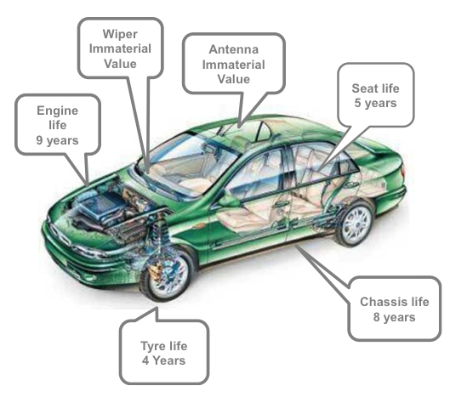
Component Accounting
On initial recognition, cost of PPE is required to be allocated on each significant part of PPE including non physical part.
Each such part should be depreciated separately

Slide 15
Disclosure
Measurement basis for the gross carrying amount
Reconciliation of carrying amount
Useful life, method of depreciation and depreciation rate
Accumulated depreciation and impairment
Disclosure of revaluation
Other disclosures

Slide 16
Major differences between IND AS 16 and AS 10
IND AS 16
AS 10
Component Accounting mandatory
Annual year end review of useful life, method of depreciation and residual values
Cost of dismantling and removing the item and restoring the site included as an element of cost
Component Accounting optional
Does not require year end review
No specific guidance

Slide 17
THANK YOU

